Slide 1
Finding the best place for Yoga Studio in Toronto
Design By: Mehrnoosh Nobakht

Slide 2
Introduction Business Problem
Yoga studios are essential for everyone. In this digital, social, media-energized virtual world, it is evident to me that people still crave human connection. Yoga studio is a place for gathering. A place where hearts can connect. A place where interaction and relationships develop in personal face-to-face relationships. Yoga helps people of all ages physically, mentally and emotionally and it can give them special vitality to perform daily activities. Given the competition of clubs to attract customers, the project is looking for a suitable location in Toronto to establish a yoga studio.
Objective
The objective of this project is to find the best neighborhood in Toronto to open a Yoga Studio using Foursquare location data.

Slide 3
Problem Description
We will look for locations that are not already crowded with Yoga studios. We are also particularly interested in areas with no nearby Yoga studio. If the first two conditions are met, we would also prefer locations as close to the city center as possible.
Based on this criterion, we will use our data science skills to generate a few promising neighborhoods. The benefits of each area will then be clearly expressed so that stakeholders can choose the best possible final location.

Slide 4
Target Audience
Business people who want to invest or open a startup Yoga studio.
The individual who wishes to run their own yoga studio as a side business.
Marketing firms that want to choose the best location to offer their services and products.
Research Question
I will attempt to answer these questions:
“Where should I open a yoga studio in Toronto?”
"Which factors are important for choosing the best location to start up a Yoga Studio?"

Slide 5
Data Description
Based on definition of our problem, factors that will influence our decision are:
number of existing yoga studio in the neighborhood
number of and distance to yoga studios in the neighborhood, if any
List of Boroughs and neighborhoods of Toronto with their geodata (latitude and longitude)
distance of neighborhood from city center

Slide 6
To do this project we need the following data: 1. Toronto City data that contains Borough, Neighborhoods along with there latitudes and longitudes Data Source: https://en.wikipedia.org/wiki/List_of_postal_codes_of_Canada:_M 2. Geographical Location data using Geocoder Package Data Source: https://cocl.us/Geospatial_data 3. Yoga studio Data using Foursquare API Data Source: https://foursquare.com/developers/apps All data related to locations of Yoga Studio will be obtained via the FourSquare API utilized via the Request library in Python. Foursquare is a US tech company from New York focusing on location data. We can get the name, latitude and longitude for each venue. Data Preprocessing We use data preprocessing to clean the dataset. We do the following preprocessing operations: Drop rows having null value and value assigned as "Not assigned" Process the cells that have an assigned borough Get the latitude and the longitude coordinates of each Postal code Merging the geographical data frame with neighborhood data frame according to the Postal Code

Slide 7
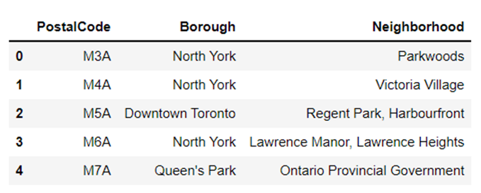
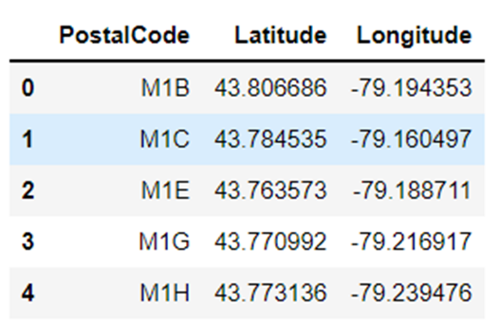
Our Neighborhood Candidate Data is shown in the below table.
After cleaning data, we should add the Latitude and Longitudes of each location.
We build a data frame of the postal code of each neighborhood along with the borough and neighborhood name.

Slide 8
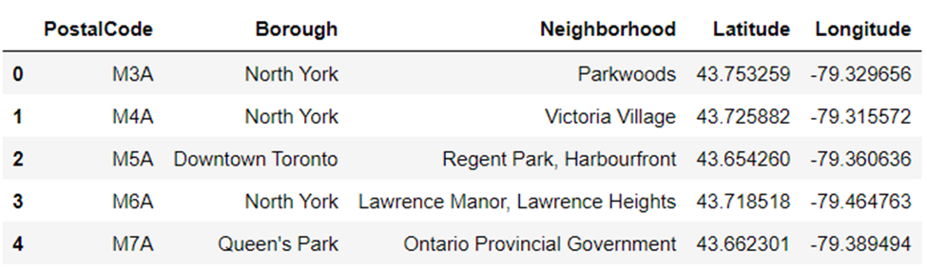
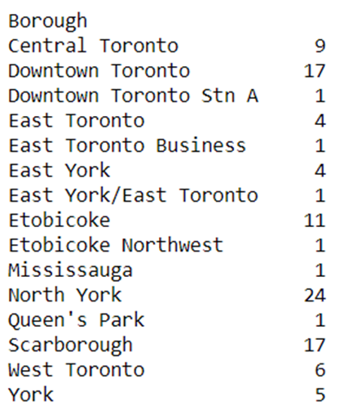
We merge the geographical dataframe with neighborhood dataframe according to the Postal Code
we find out how many neighborhoods are in each borough

Slide 9
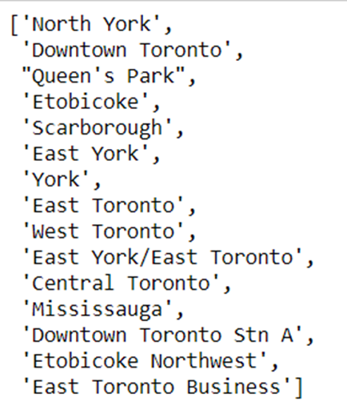
Visualizing all the boroughs in Toronto
Create a list and store all unique borough names
The geographical coordinates of Toronto are
43.704607733980595, -79.3971529116505

Slide 10
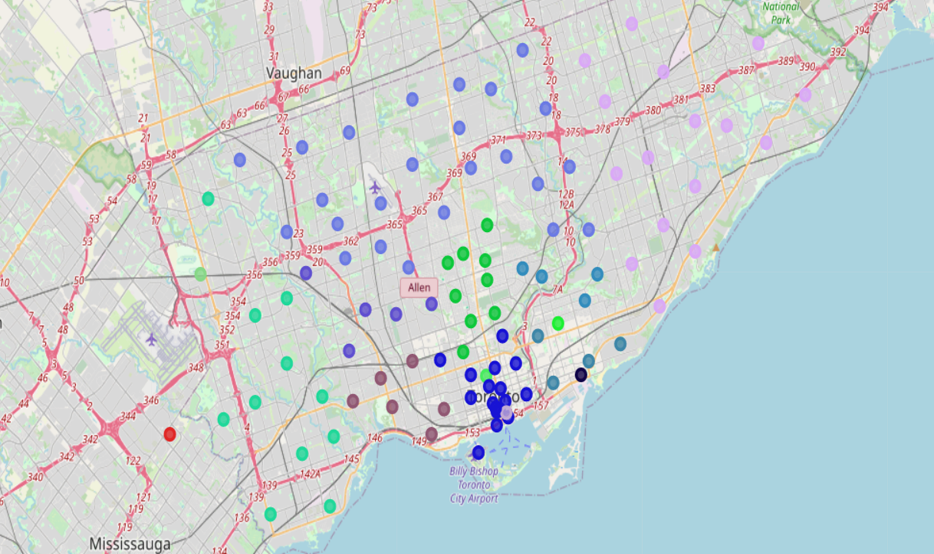

Slide 11
Methodology
In this project, we will focus our efforts on identifying areas of Toronto with a low number of yoga studios. We will limit our analysis to an area ~5km around the city center. In the first step, we gathered the necessary information: the location of every Yoga studio within 5 kilometers of the Toronto center, as determined by Foursquare data.
The second step in our analysis will be the calculation and exploration of 'yoga studio density' across different areas of Toronto - we will use heatmaps to identify a few promising areas close to the center with a low number of yoga studios and focus our attention on those areas.
In the third and final step, we will concentrate on the most promising areas and within those create clusters of locations that meet some basic requirements established in discussion with stakeholders:
We will take into consideration locations without Yoga studios within a radius of 500 meters. We will present a map of all such locations but also create clusters (using k-means clustering) of those locations to identify general zones/neighborhoods/ addresses which should be a starting point for final 'street level' exploration and search for optimal venue location by stakeholders.

Slide 12
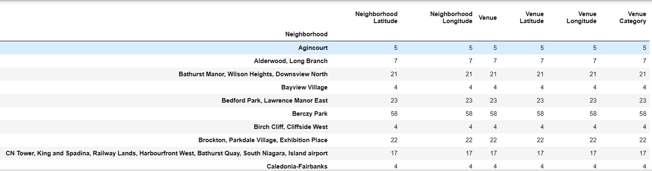
Data Analysis
Let's perform some basic explanatory data analysis and derive some additional info from our raw data. First let's count the number of yoga studio in every area candidate.
The number of venues per neighborhood
There are 272 unique venue categories.
We analyze each neighborhood
The column "Venue Category" has a categorical value. As a result, we must convert it to numerical values using one hot encoding.

Slide 13
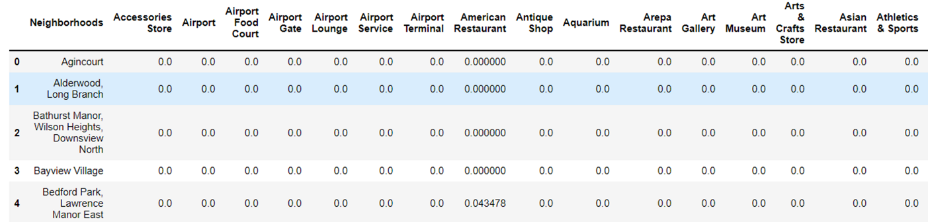
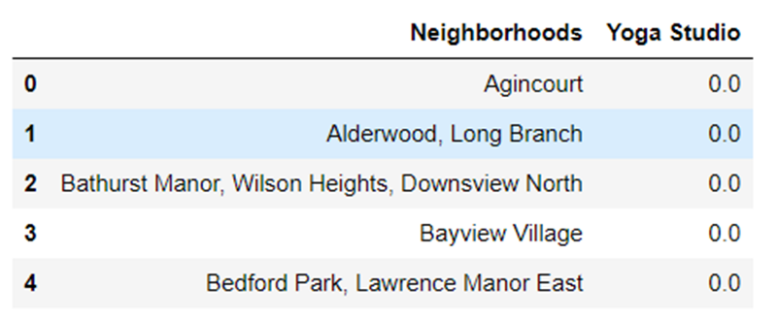
Then group rows by neighborhood and by taking the mean of the frequency of occurrence of each category
Here we only require the "Neighborhoods" and "Yoga Studio" columns for the clustering. So, we'll group these two columns.

Slide 14
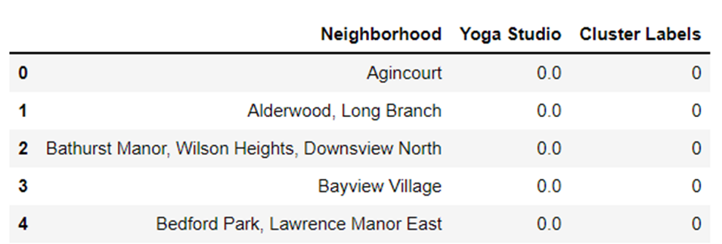
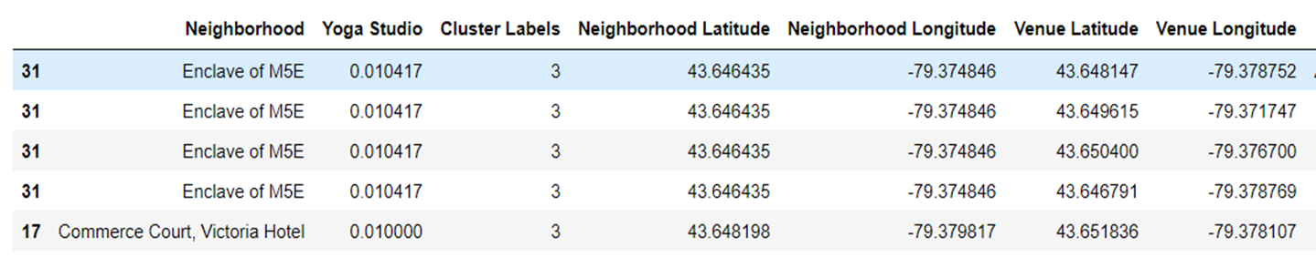
We will use k-means algorithm for clustering (k=4).
Then we create a new dataframe that includes the cluster as well as the top 10 venues for each neighborhood.
We merge toronto_grouped with toronto_data to add latitude/longitude for each neighborhood
We see that there are a total of 14 locations with yoga studio in Toronto

Slide 15
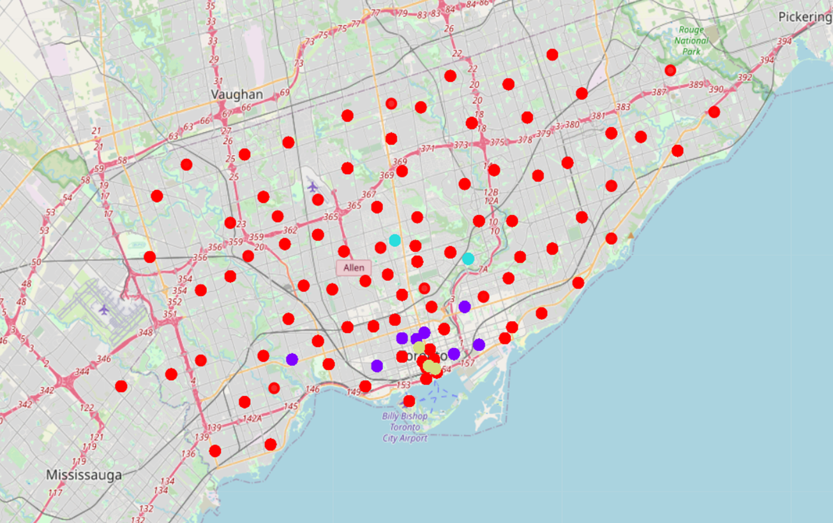
Visualize the Clusters on Map

Slide 16
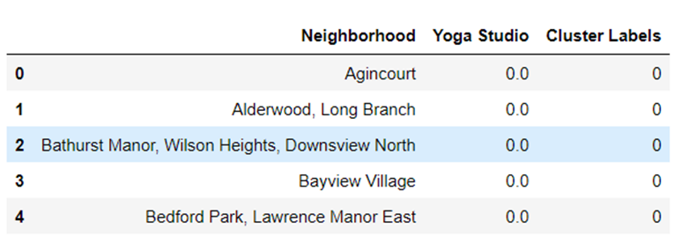
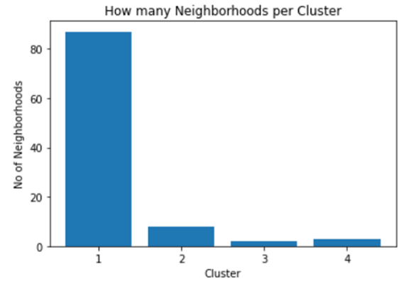
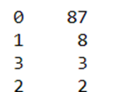
Number of Neighborhoods in each Cluster
Number of neighborhoods in each cluster

Slide 17
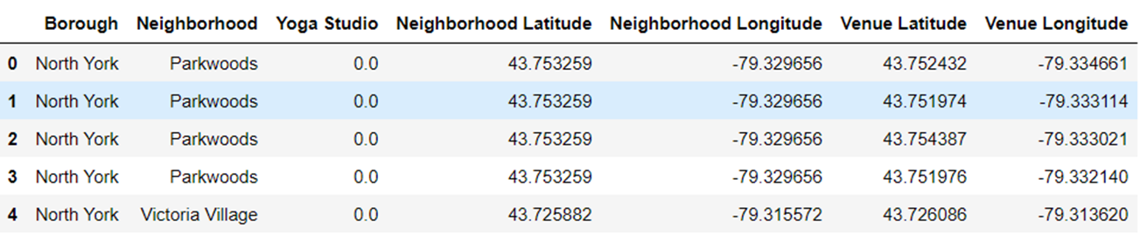
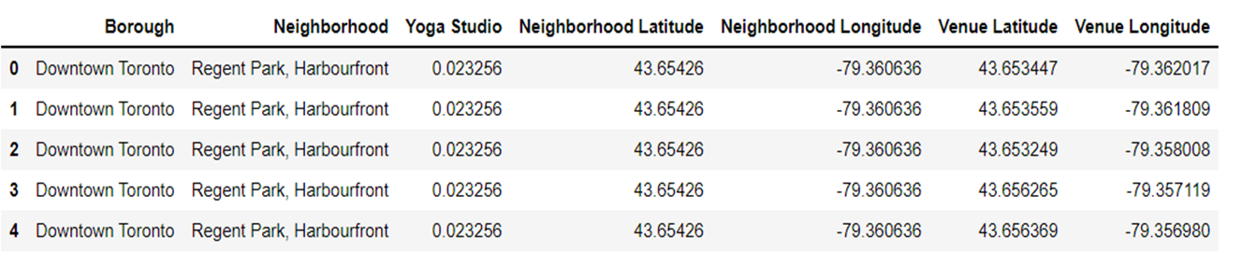
Results
Cluster 1
Cluster 2

Slide 18
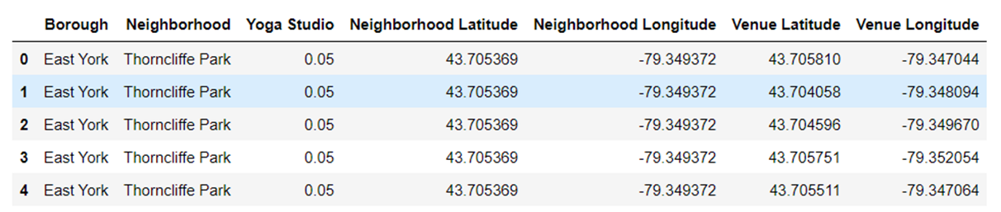
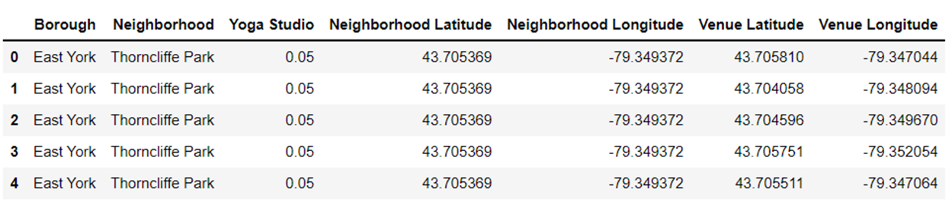
Cluster 3
Cluster 4

Slide 19
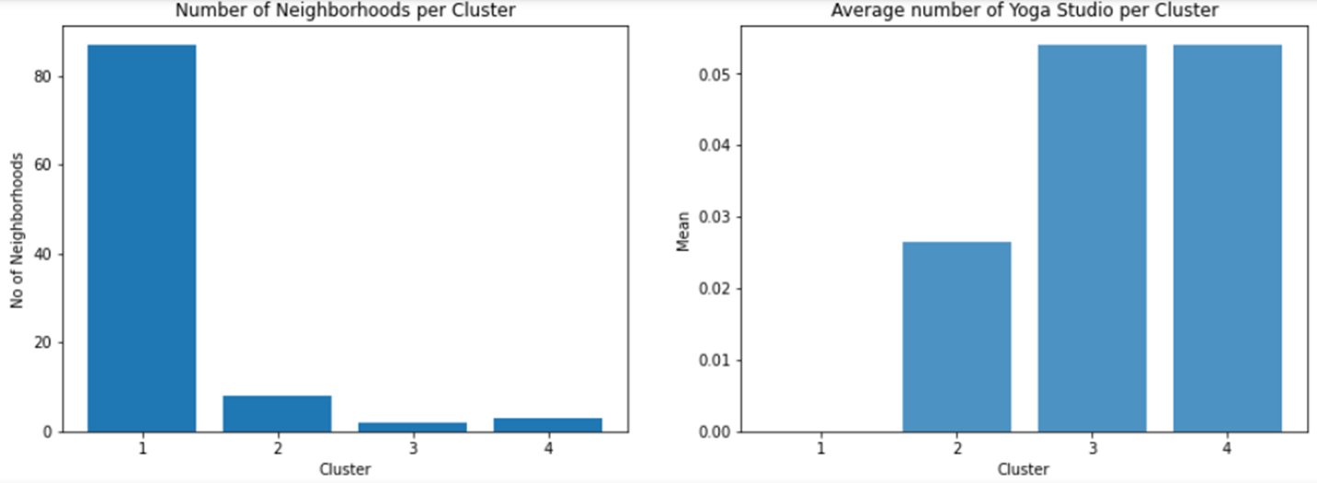
Number of neighborhoods per cluster vs Average number of yoga studio in each Cluster

Slide 20
Discussion
The East York neighborhood of Toronto (cluster-3) has the highest average number of yoga studios.
Downtown Toronto has the second-highest concentration of yoga studios.
Looking at nearby venues, the best location for a new yoga studio is Parkwood, North York (cluster-1) because there are many Neighborhoods in that area but only a few yoga studios, removing any competition.
The second-best neighborhoods with a lot of potential are in Cluster-1, such as Victoria Village in North York. In this area, there is a good opportunity to open a new yoga studio.
Conclusion
This concludes the best findings for this project and advises the entrepreneur to open a yoga studio in these areas where there is little to no competition.
The k-Means algorithm is used for clustering the neighbors in city during this project.
Here we take a yoga studio as an example. We can do the same process to find the best place or neighborhood to open a start-up company.

